Slide 1









MINDFULNESS
SERIES

Slide 2

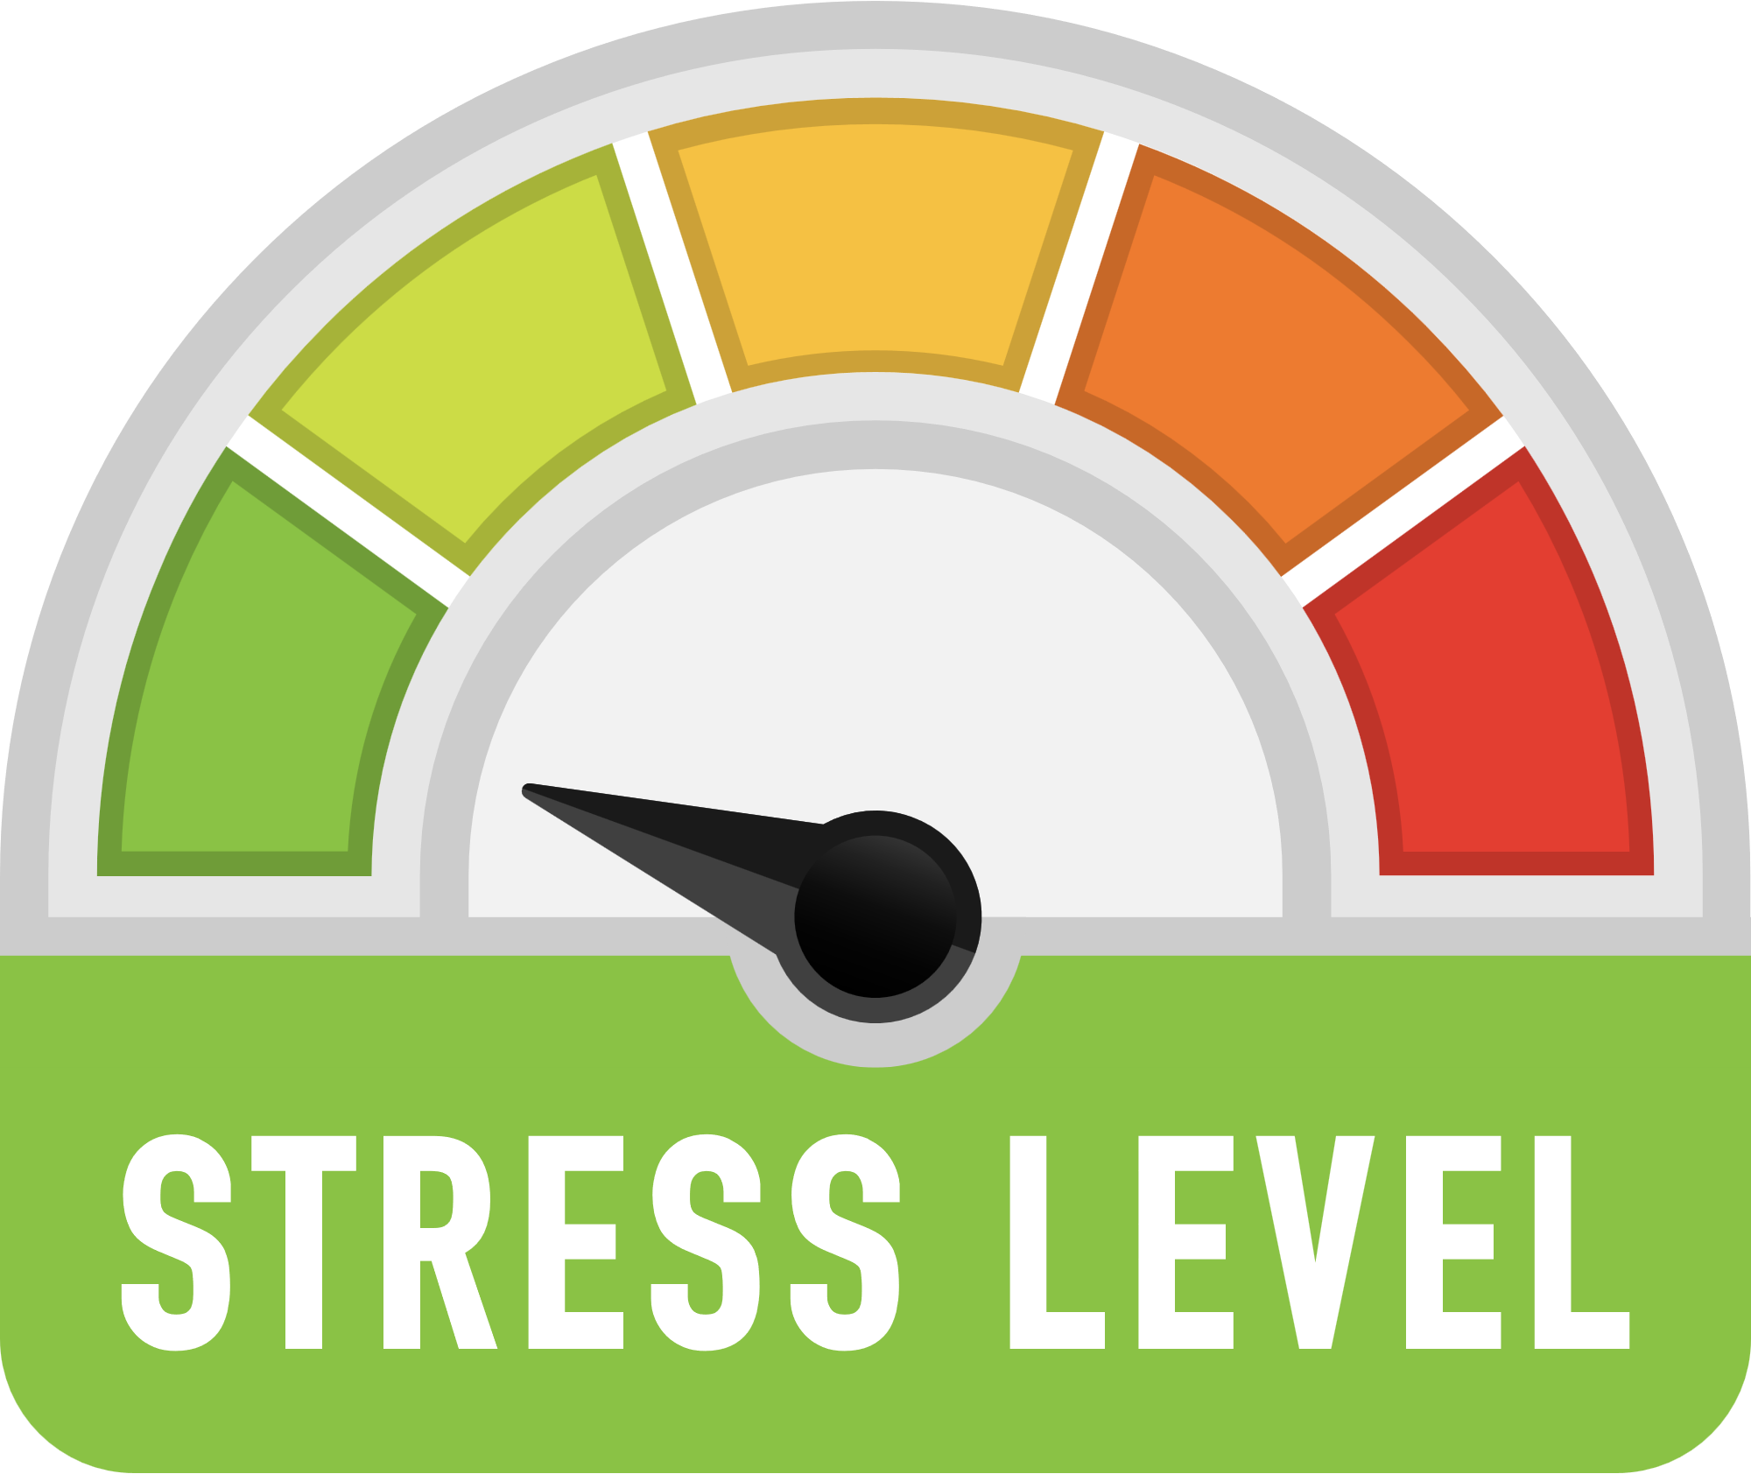


CHECK IN!
On a scale of 1-10 rate your stress level this week?
What’s one thing you’re looking forward this week?
Notes:
Ask for Check-In prompt during Drop in prep

Slide 3

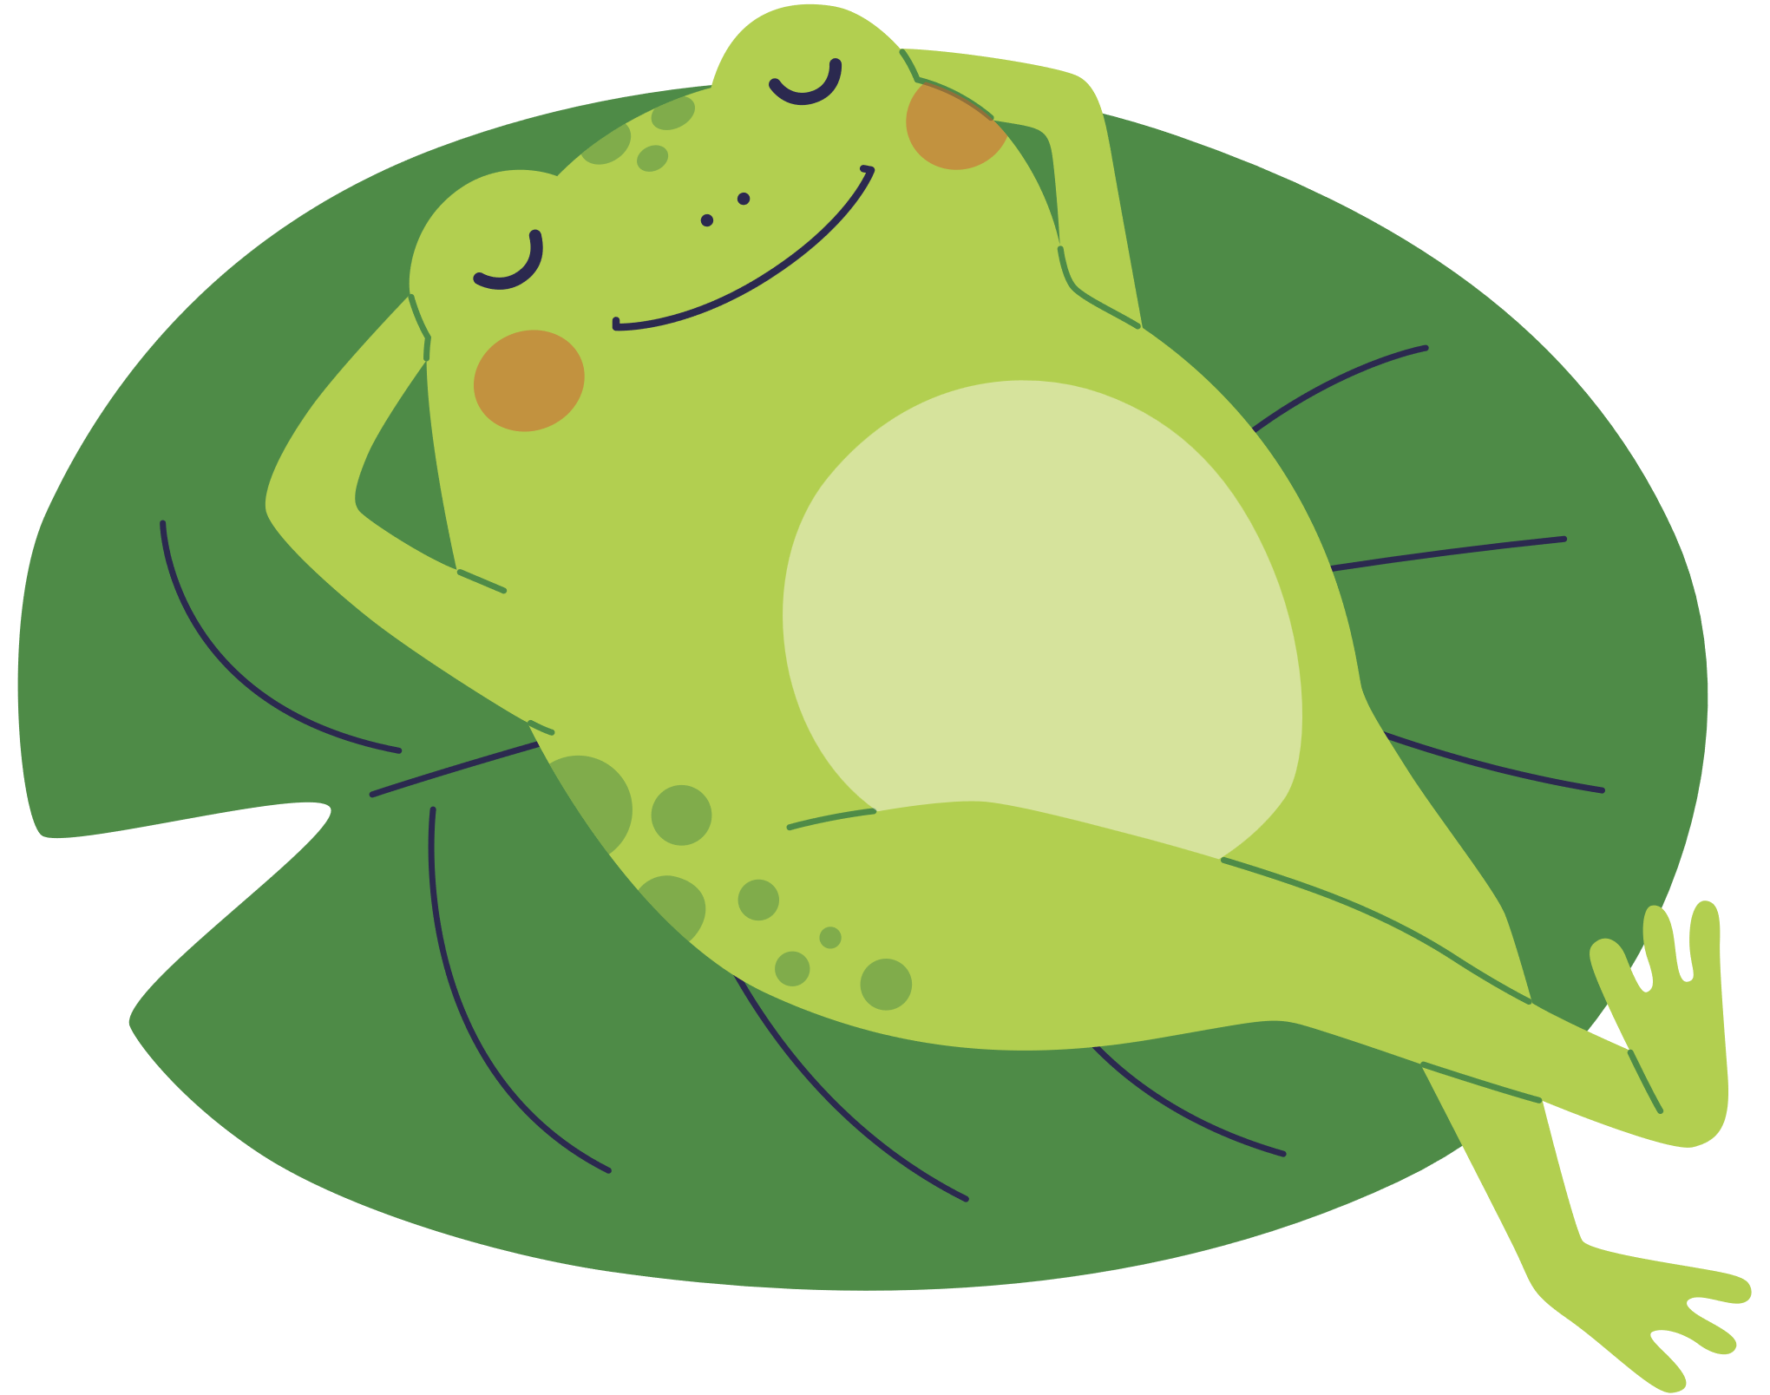



LET’S GET SETTLED...

Slide 4



SO WHAT’S STRESS?
Stress can be thought of as our body’s physical and emotional response to a perceived threat or challenge.
While some stress can be helpful, enabling us to perform at a heightened level when needed, too much stress can lead to all sorts of physical and emotional health problems...
Notes:
Add Graphics depicting positive and negative stress

Slide 5


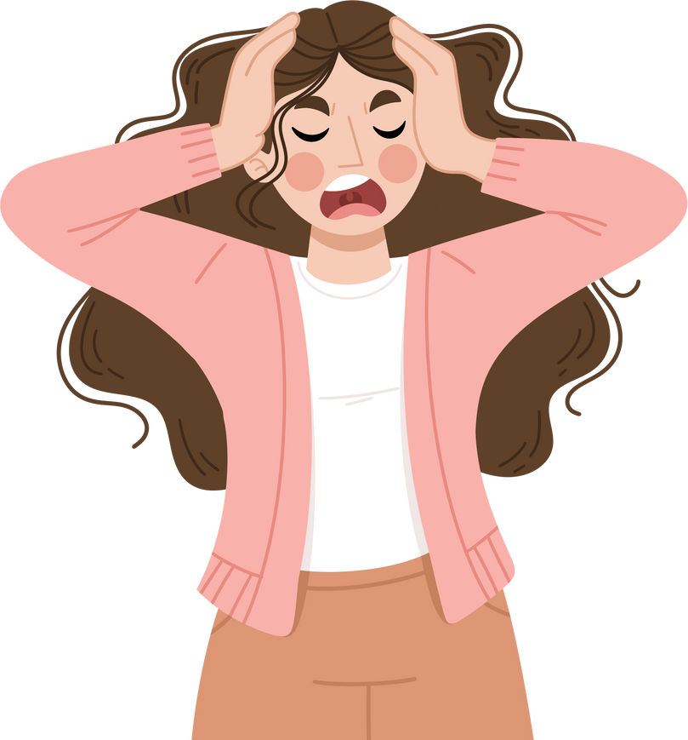

WHERE DOES OUR STRESS COME FROM?
Much of the stress we experience comes from our tendency to dwell on the past or worry about the future...
We perceive many of these threats or challenges in our mind, often when they have either already passed, or haven’t yet occurred, thereby tricking our brain into triggering our stress response...
Many of negative emotions and even physical problems stem from an overload of stress which can include anxiety, anger, irritability, guilt and shame...
Notes:
Mention during prep meeting:
Stress is a general terms that include physical (over-exertion, infection, sleep deprivation etc.) as well as psychological. For this series for our focusing on the psychological and emotional sources of stress...

Slide 6



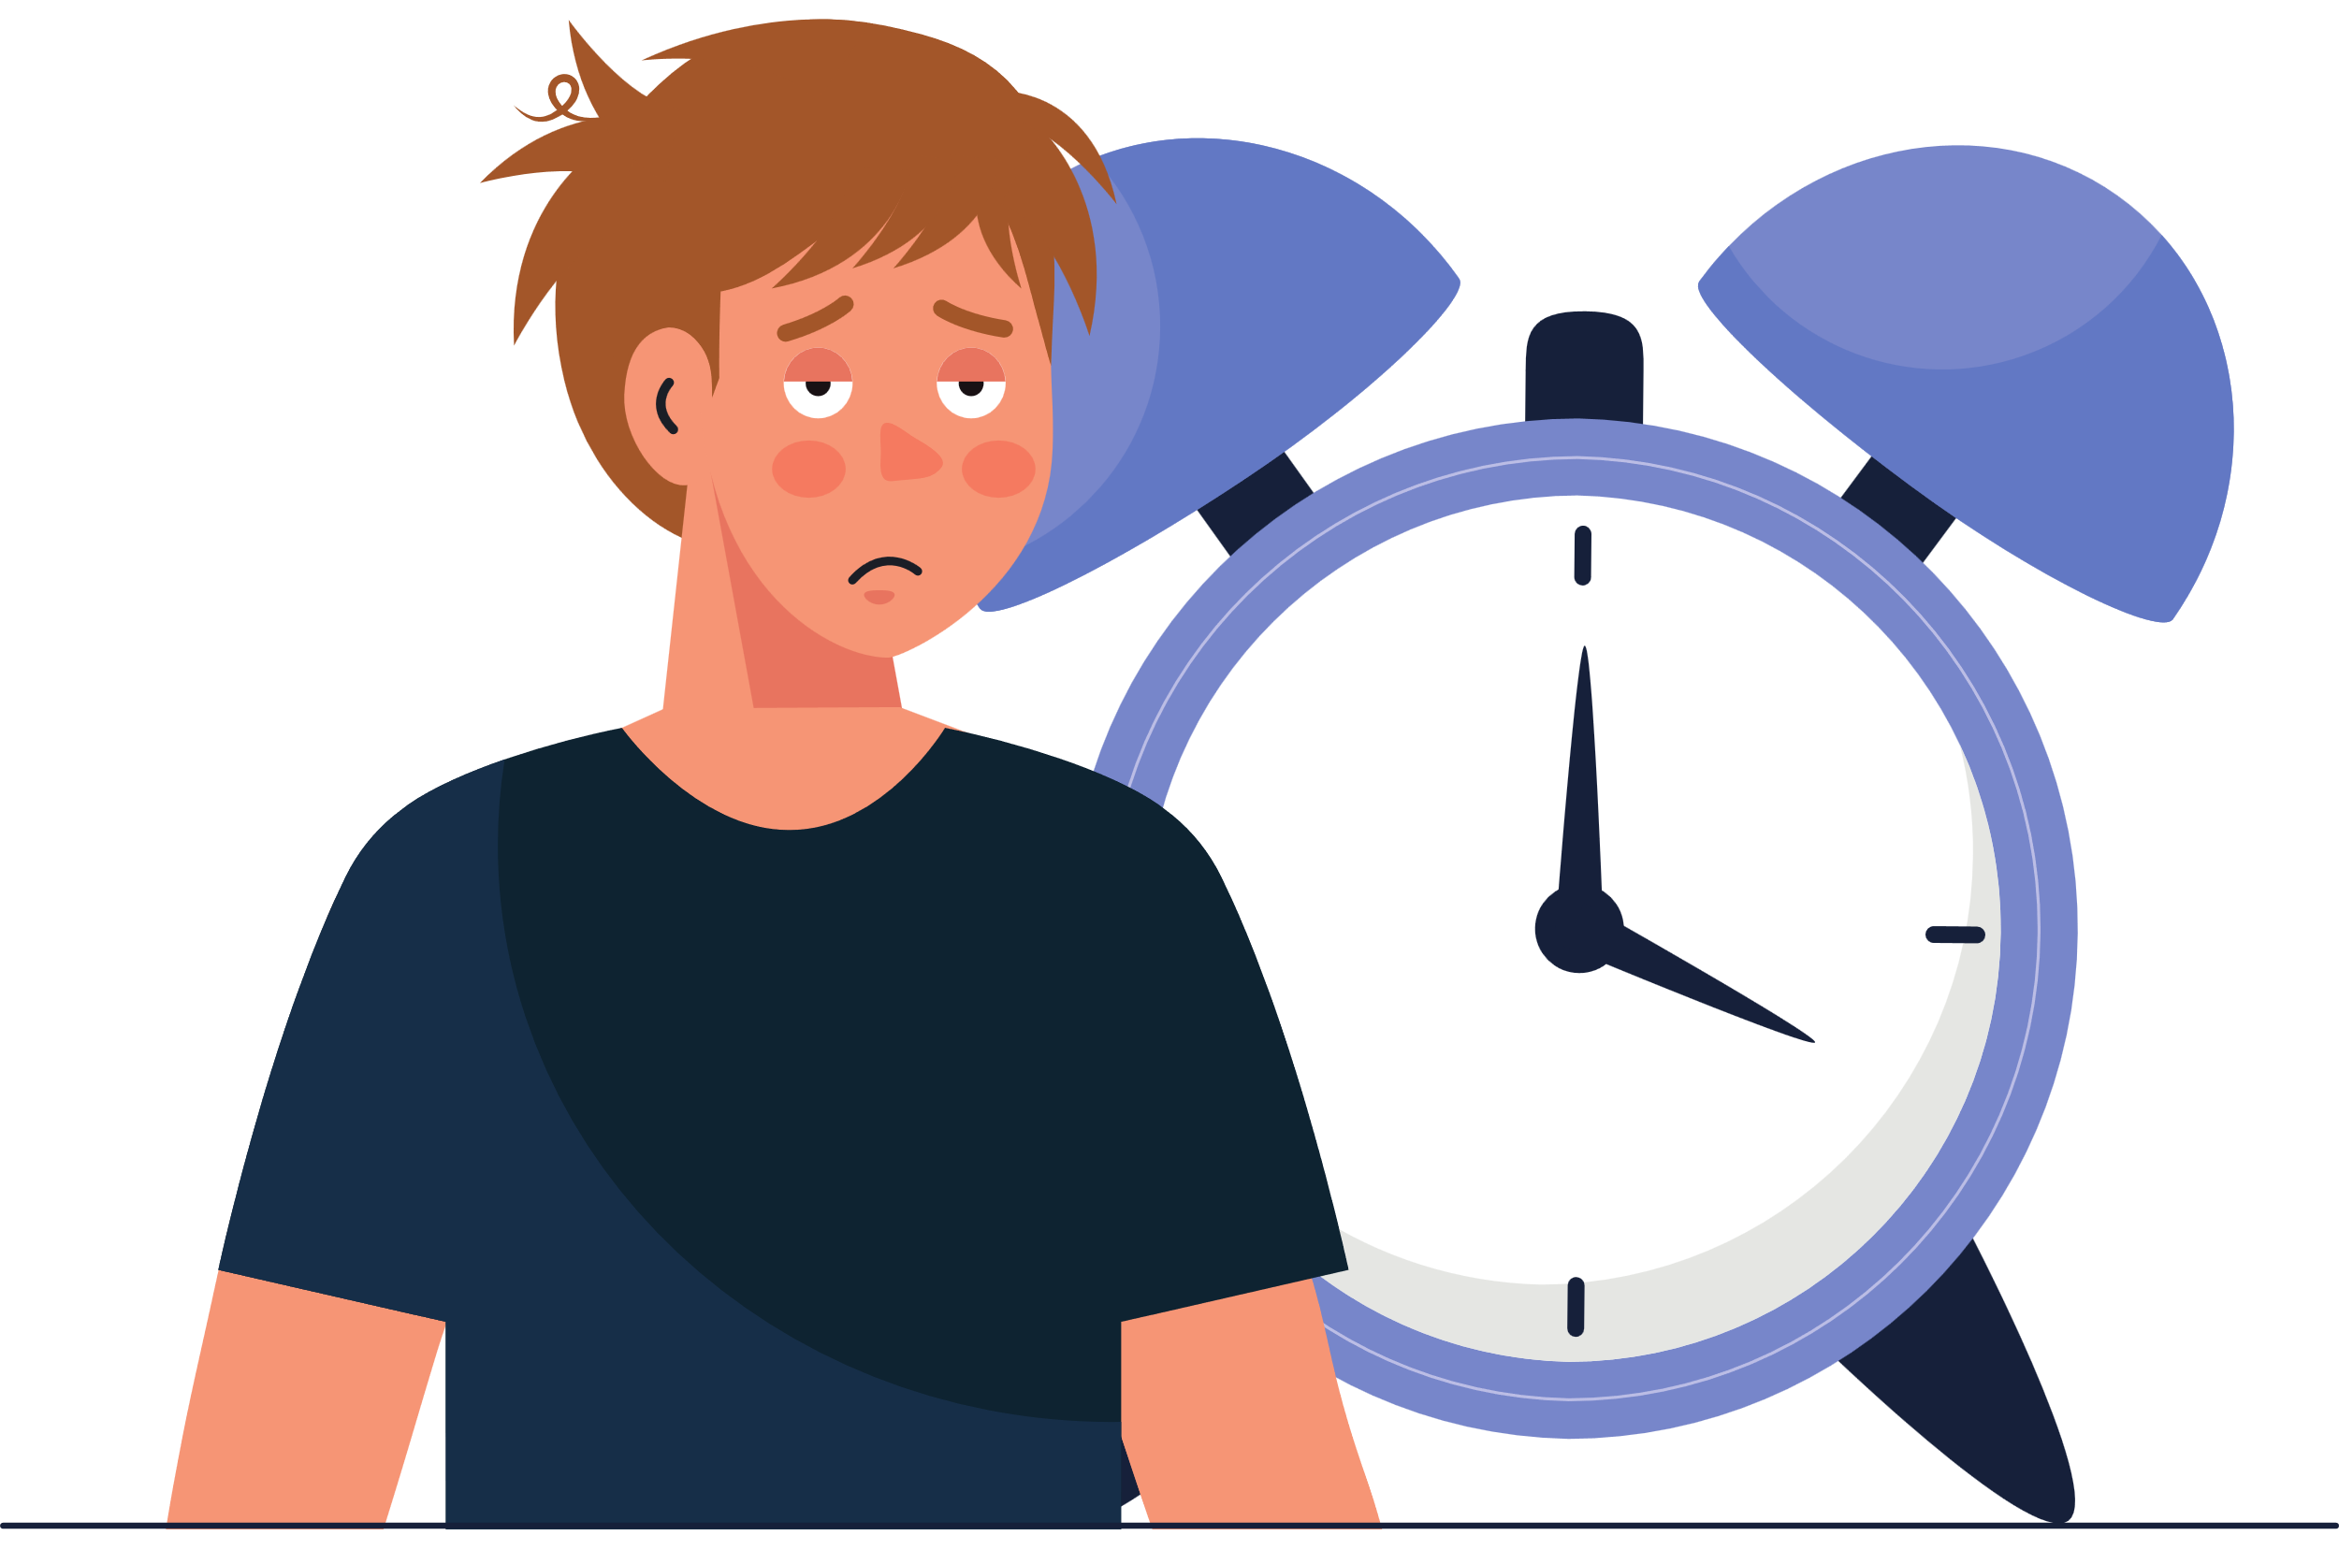
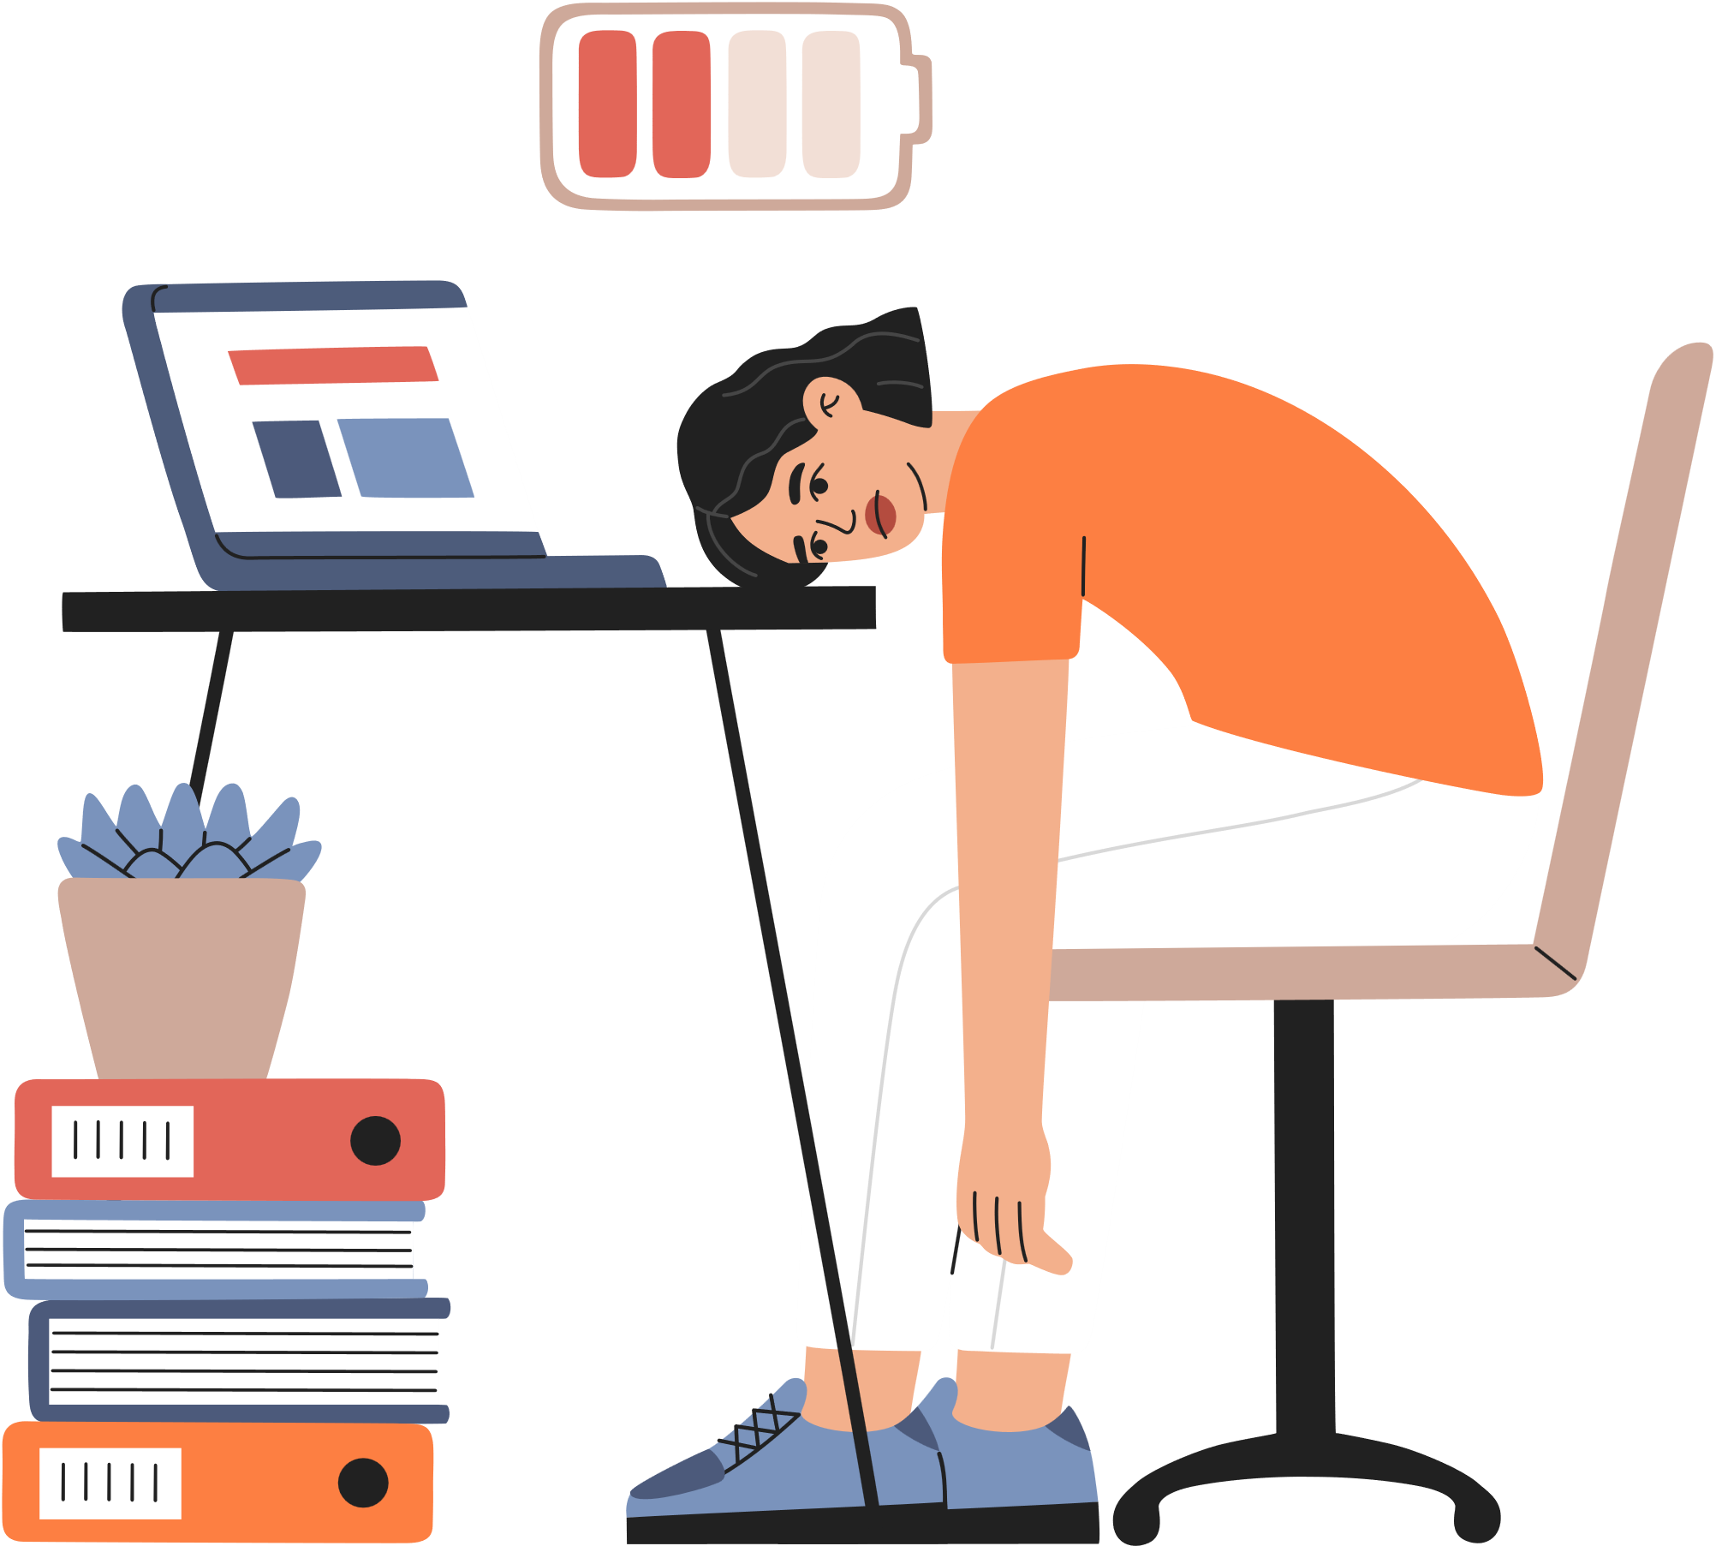

SIGNS OF TOO MUCH STRESS...
PHYSICAL SIGNS
Sleep Disruptions
Digestive Problems
Fatigue
Headaches & Brain Fog
Notes:
Add bars to separate each graphic with
Some of common signs of too much stress include:
Emotional: Anxiety, Depression, Irritability, Restlessness
Physical:
Headaches: overstimulation,
Poor Sleep: inability to fall and stay asleep, poor sleep quality and feeling not well rested
Concentration and Brain Fog: memory problems, and
Digestive Problems: Bloating, diarrhea, indigestion and pain

Slide 7
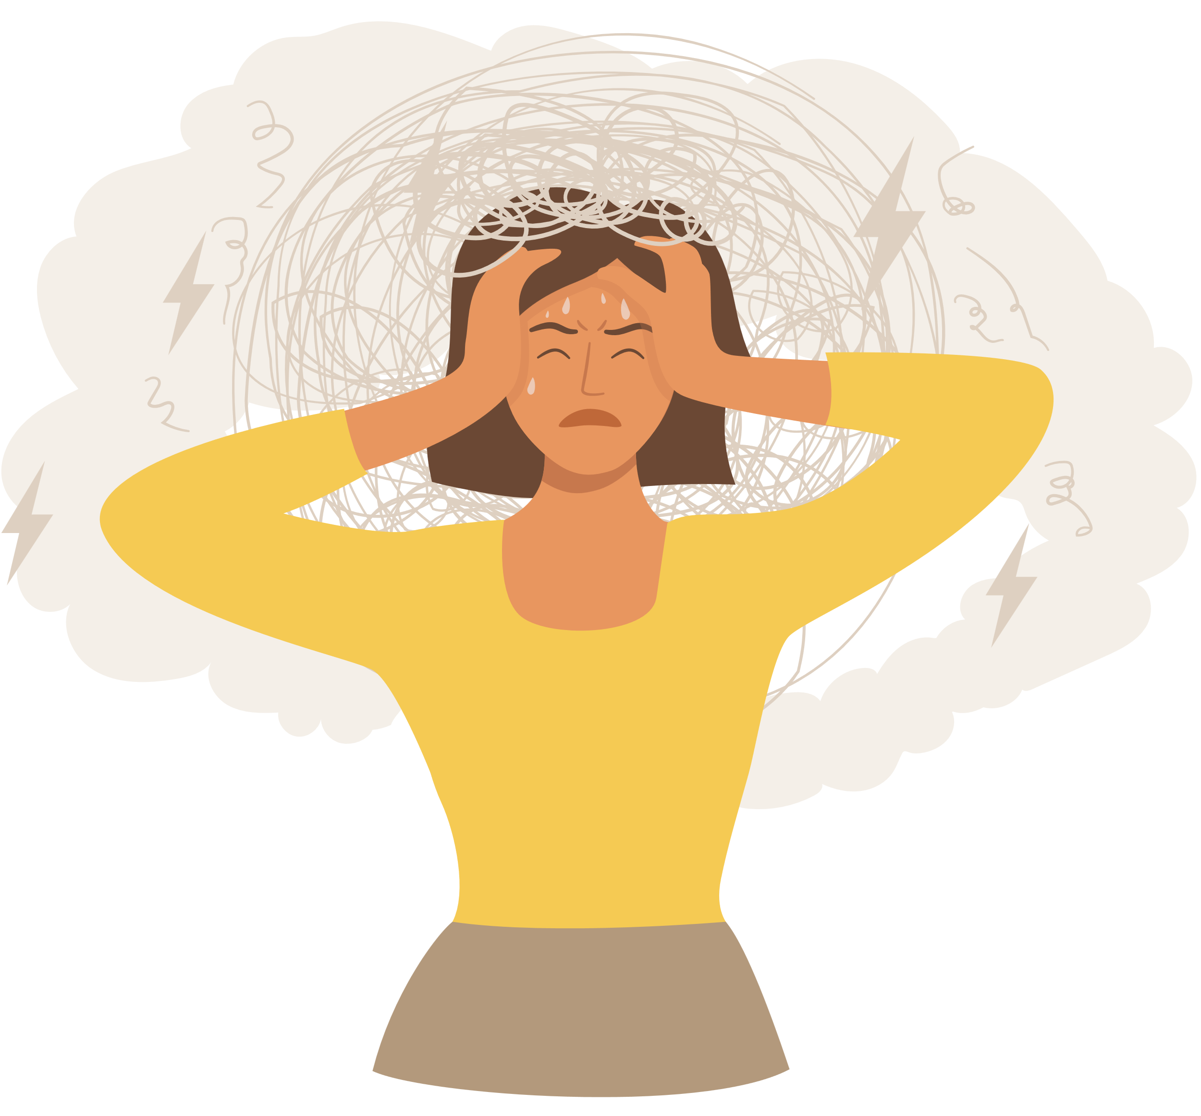



SIGNS OF TOO MUCH STRESS...
EMOTIONAL SIGNS
Anxiety
Depression
Irritiability
Restlessness
Notes:
Add bars to separate each graphic with
Some of common signs of too much stress include:
Emotional: Anxiety, Depression, Irritability, Restlessness
Physical:
Headaches: overstimulation,
Poor Sleep: inability to fall and stay asleep, poor sleep quality and feeling not well rested
Concentration and Brain Fog: memory problems, and
Digestive Problems: Bloating, diarrhea, indigestion and pain

Slide 8



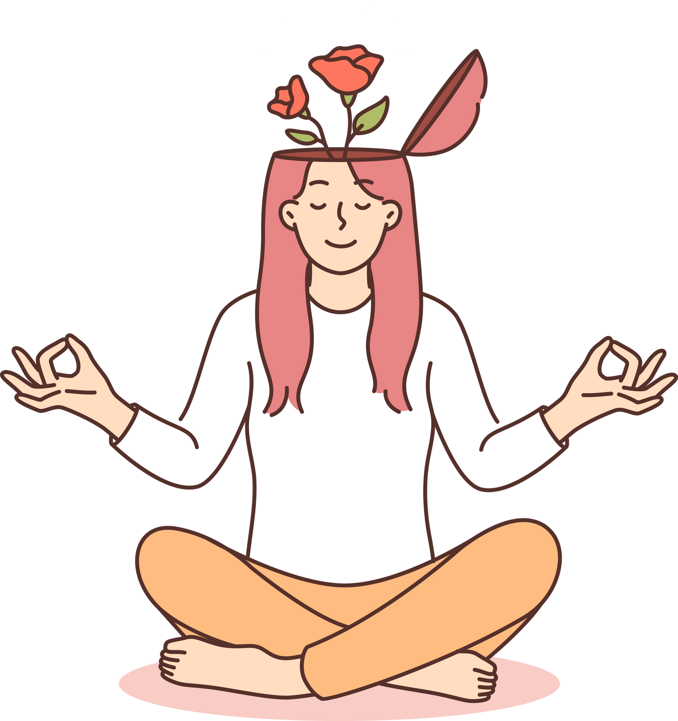
WHAT IS MINDFULNESS ?
Mindfulness is the practice of being aware of your current thoughts, feelings, and emotions without judgment or avoidance.
It involves being present and engaged in the moment, rather than dwelling on the past or trying to predict the future.

Slide 9

MINDFULNESS =
ATTENTION + INTENTION
Mindfulness is a conscious process of awareness: Attention
Mindfulness requires an intentional effort and practice: Intention

Slide 10





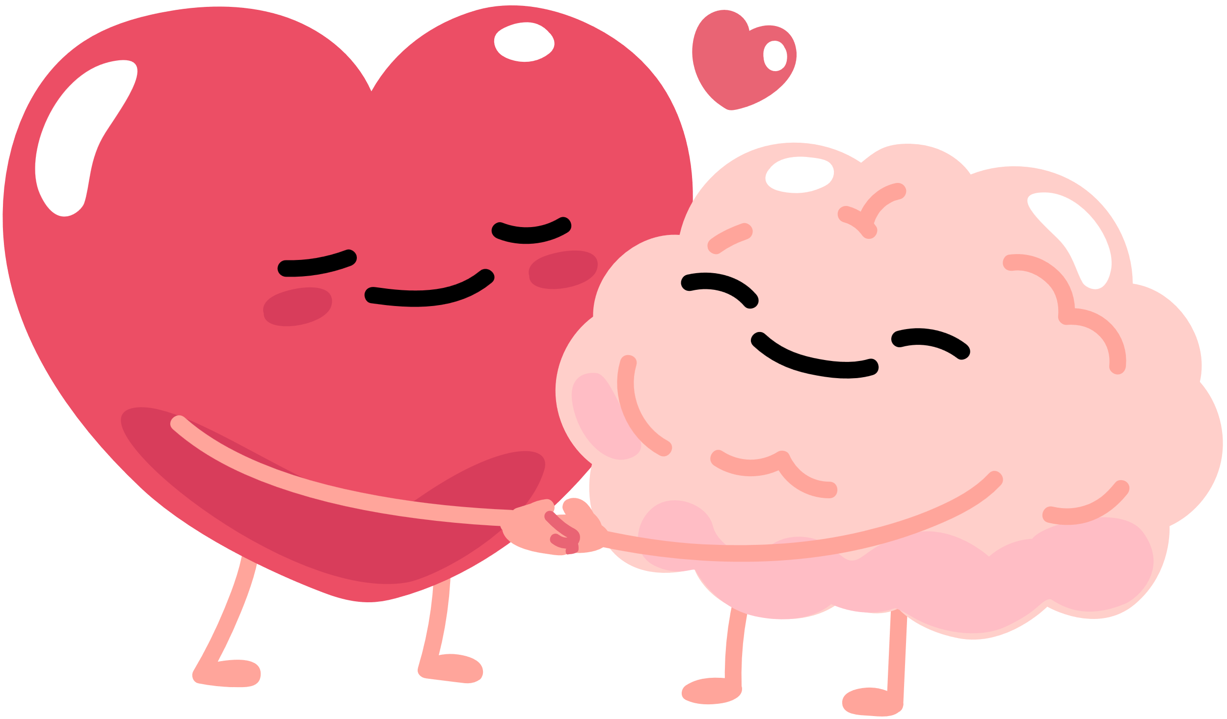
BENEFITS OF MINDFULNESS
  Better coping with illness
  Increased self-awareness
  Increased enthusiasm for life
  Stress reduction
  Improved self-esteem
  Improved concentration
  Improved emotional regulation

Slide 11



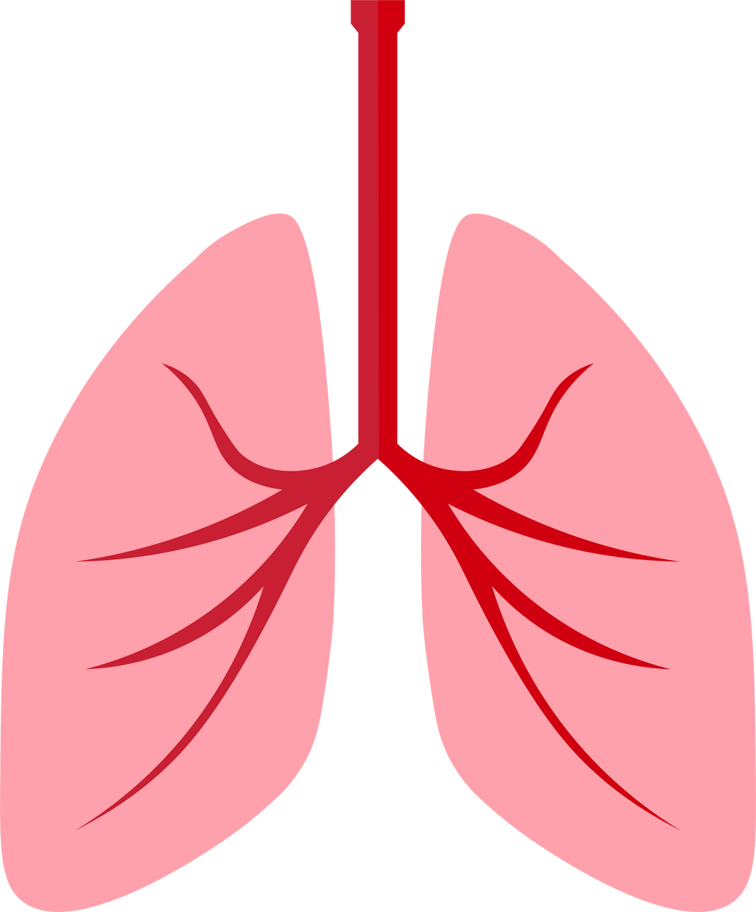





COMMON MINDFULNESS PRACTICES
Yoga
Journaling
Meditation
Conscious Breathing
Silent Reflection
Connecting with Nature
Grounding Exercises
Creative Expression
Notes:
Presenter Notes: Some of these you may already be familiar with, if not, don't worry, we will cover more in the coming weeks.

Slide 12

HOW DO YOU PRACTICE MINDFULNESS?

Slide 13



HERE’S SOMETHING TO TRY AT HOME
5 MINDFUL MINUTES
AM + PM
  Find a comfortable position
  Draw your awareness to your breath
  Begin to slow your breathing
  Focus on your body
  Notice your thoughts
Repeat
Notes:
1. Find a comfortable position: Sitting or lying down.
2. Draw your awareness to your breath: Observe how your breath is moving in and out, and whether it's deep or shallow.
3. Begin to slow your breathing: Inhale enough air to fill your lungs, then exhale slowly.
4. Focus on your body: Feel your chest rise and fall, or the sensation in your nostrils.
5. Notice your thoughts: When your mind wanders, gently bring your attention back to your breath.
Repeat: Continue to practice mindful breathing, trying to maintain a steady rhythm.
Set a goal for at least 5 mins twice a day for the next week.

Slide 14


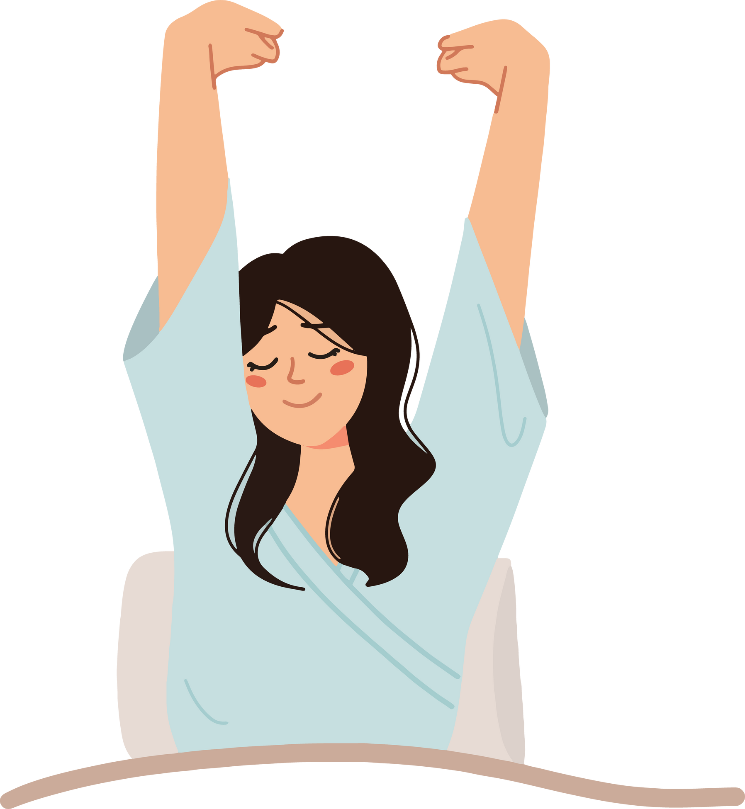


MINDFULNESS CHALLENGE
5 MINDFUL MINUTES
AM + PM
Set a goal for at least 5 mins twice a day for the next week.
Notes:
Commit to spending 5 minutes of mindfulness, after waking and before going to sleep.
You will likely notice a sense of calm and focus to start your day
And...
And an easier time falling and staying asleep, once you're mind is settled and no longer dwelling on the day or anticipating tomorrow.

Slide 15
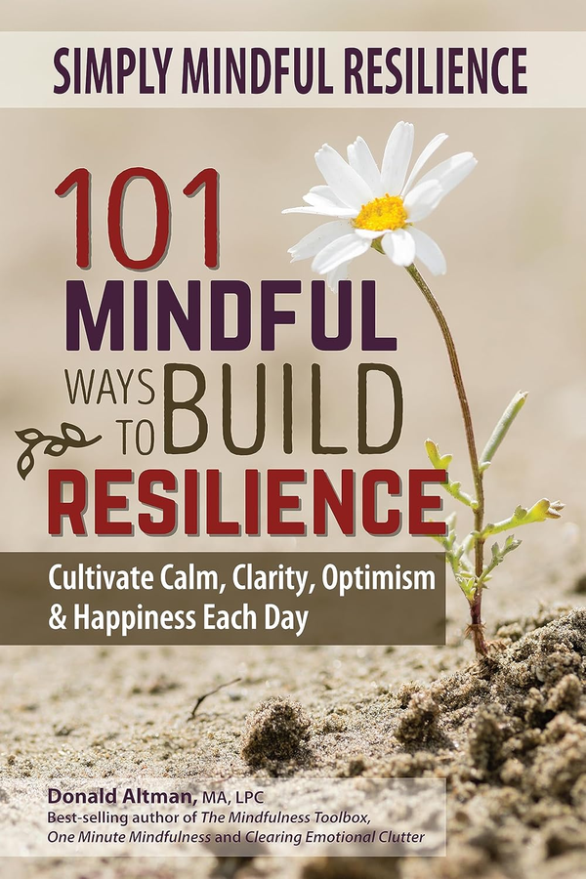
“101 MINDFUL WAYS TO BUILD RESILIENCE”
If this subject resonates with you and you would like to learn more,
check out this book, and be sure to stay tuned next week for the next
episode in our
Worker2Worker“Mindfulness Series”

Slide 16
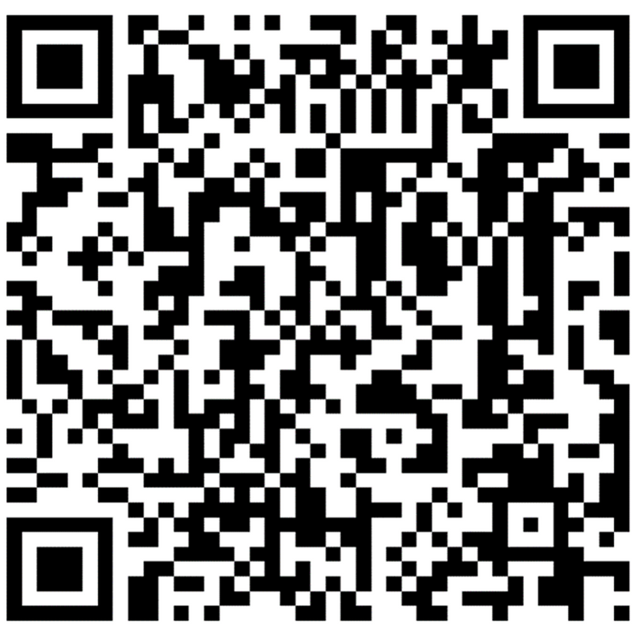

WORKER 2 WORKER PROGRAM INFORMATION
Please feel free to complete the confidential form in the chat
or
Scan the QR code so we can stay connected to you moving forward!
Phone: 1-855-327-7482
Email: worker2worker@ubhc.rutgers.edu
Website: worker2worker.com

