Slide 1



#1
WHOLE HEARTED
LIVING

Slide 2




CHECK IN!
What is one New Years Resolution that you have kept up with? If you have fallen off the bandwagon, why and what can you do to get back on?

Slide 3


LET’S GET SETTLED…
5 Deep Breaths, Inhaling through your nose…5 Deep Exhales, blowing out of your mouth, blowing all the air out from your belly…

Slide 4

INTRO TO THE GIFTS
OF IMPERFECTION​
  Brene Brown’s Road Map to Wholehearted Living
  “Wholehearted living is about engaging in our lives from a place of worthiness.”​
  How do we live a wholehearted life? ​
  We must know and understand ourselves so we can then love ourselves.​
  Over the next 10 weeks we will be taking steps to living a wholehearted life…

Slide 5


1
GUIDEPOST #1: CULTIVATING AUTHENTICITY; LETTING GO OF WHAT PEOPLE THINK
“Often people attempt to live their lives backwards: they try to have more things, or more money, in order to do more of what they want so that they will be happier. The way it actually works is the reserve. You must first be who you really are, then do what you really need to do, in order to have what you want.”​
-Margaret Young

Slide 6

CULTIVATING AUTHENTICITY​
  Authenticity is a practice, its choice we have to make each day ​
  What is the decision we have to make? ​
  To let our true selves be seen ​
  This can be difficult in the society we live in today! ​

Slide 7

IS SHAME OR SELF-DOUBT IN THE DRIVER SEAT?
Authenticity is the daily practice of letting go of who we think we’re supposed to be and embracing who we are.
SHAME
SELF-DOUBT

Slide 8

HOW TO CHOOSE AUTHENTICITY ​
  Cultivating the courage to be imperfect, to set boundaries, and to allow ourselves to be vulnerable ​
  Exercising the compassion that comes from knowing that we are all made of strength and struggle​
  Nurturing the connection and sense of belonging that can only happen when we believe that we are enough
​WHEN WE CHOOSE AUTHENTICITY, WE NATURALLY LET GO OF WHAT PEOPLE THINK.

Slide 9



DIG DEEP!
“SACRIFICING WHO WE ARE FOR THE SAKE OF WHAT OTHER PEOPLE THINK JUST ISN’T WORTH IT.”
Get Deliberate!
Find a mantra that grounds you!
Get Inspired!
Courage is contagious! Find someone or something that inspires you.
Get Going!
Next time you are experiencing vulnerability, allow yourself to be authentic.

Slide 10



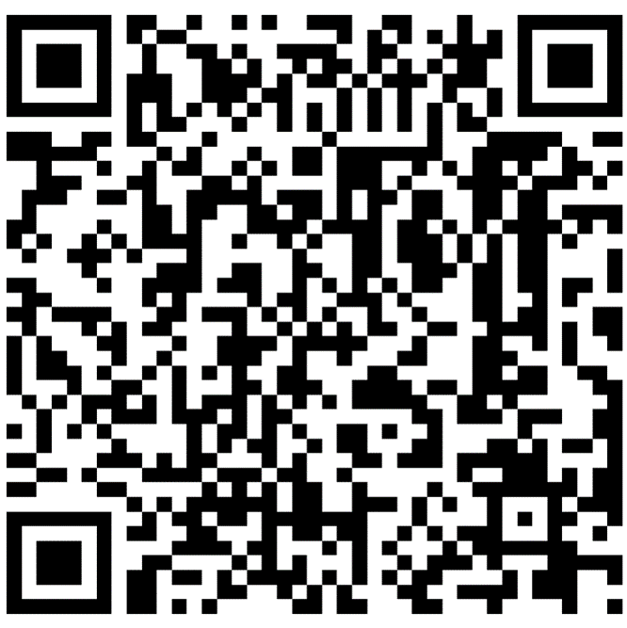
Worker2Worker Program Info:
Please feel free to complete the confidential form in the chat
or
Scan the QR code so we can stay connected to you moving forward!
Phone: 1-855-327-7482
Email: worker2worker@ubhc.rutgers.edu
Website: worker2worker.com

